Slide 1
2013-2014
Financial Aid Night
PRESENTED BY
University of Michigan
Office of Financial Aid

Slide 2
Today’s Discussion Topics
What is Financial Aid?
Cost of Attendance (COA)
Expected Family Contribution (EFC)
Financial Need/Net Price Calculator
Sources of Financial Aid
Types of Financial Aid
Completing the FAFSA: Why, Who, When & How
What Happens Next
Special Circumstances
Deric’s Tips & Pointers

Slide 3

Financial Aid IS…
funding provided to students and families
to help pay for post-secondary
education and educationally related expenses.

Slide 4



Financial Aid is NOT…

Slide 5

Cost of Attendance
DIRECT cost:
paid to the University
Tuition and fees
  Block tuition
  Per credit hour
Room and board
Will receive a bill
twice per year

Slide 6
Cost of Attendance
INDIRECT cost:
Books and supplies
Personal/ Miscellaneous expenses
Transportation
Notes:
Direct cost are determined by the institution so they can vary from college to college. Indirect cost are expenses students can and will incur but can vary per student. An example for ways to adjust book expenses would be to purchase online or borrow from the library.

Slide 7
Cost of Attendance
TRUE or FALSE
I can use my financial aid to pay for my apartment and utilities even though I live off campus.

Slide 8
Cost Of Attendance
In-State Out-of-State
Tuition & Fees $ 6,537 $16,537
Room & Board $ 4,125 $ 4,125
Books & Supplies $ 1,048 $ 1,048
Personal/Misc. $ 2,054 $ 2,054
Total $13,764* $23,764*
* This is the maximum amount of financial aid you can receive

Slide 9
2012-2013 Cost of Attendance

Slide 10
Expected Family Contribution (EFC)
The amount a family can reasonably expect to contribute
Calculated by a federal formula with information from the FAFSA
Two components:
  Parent contribution
  Student contribution
Can range from $0 to 99,999
Stays the same at every institution

Slide 11
Financial Need
$22,150 Cost of Attendance
- 4,250 EFC
$17,900 Financial Need
This is what your financial aid award is based upon.

Slide 12
Net Price Calculator
A tool that provides estimated net costs
  Uses institutional data
  Can be tailored to your individual situation
  Check school’s financial aid website

Slide 13
Types of Financial Aid
  Grants
  Scholarships
  Work-Study
  Loans
Notes:
Grants, some scholarships, work-study and a subsidized federal loan are need based. An un-subsidized loan is not need based and student can receive one as long as there is a financial need and the FAFSA has been completed.

Slide 14
Types of Financial Aid: Grants
Free money
Awarded on the basis of financial need
Must complete FAFSA to apply
Funds applied directly to student’s university bill

Slide 15
Types of Financial Aid: Scholarships
Free money
Awarded on the basis of merit, skill, unique characteristic, or financial need
Must complete FAFSA and separate applications
Funds applied directly to student’s university bill

Slide 16
Types of Financial Aid: Scholarships
TRUE or FALSE
I should not apply for multiple scholarships because there is a limit to the number of scholarships I can receive.

Slide 17
Be Creative…
Begin researching private aid sources now
Research what is available in community
Small scholarships add up!
Foundations, businesses, charitable organizations:
  Do you or your family belong to any groups?
Deadlines and application procedures vary widely
Apply at each school you’re interested in

Slide 18
Understand Your Scholarship
One time vs renewable
If renewable, are there requirements?
  GPA
  Major
  Full-time
Tuition specific
What’s the value of the scholarship?
  Are there remaining costs?

Slide 19
Scholarships Scams
BEWARE OF
Watch for:
  Scholarships with application fee
  No contact telephone number
  Unsolicited scholarship opportunity
  Hype or pressure to participate
  Scholarship services who guarantee success
  Sales pitches disguised as financial aid “seminars”
Website: www.finaid.org/scholarships/scams.phtml

Slide 20
Types of Financial Aid: Loans
Borrowed money
Loans are in the student’s name and are
their responsibility
Repayment begins after graduation
Loans are an investment in the future
Only borrow what you really need

Slide 21
Types of Financial Aid: Loans
Must complete FAFSA and separate applications
Funds applied directly to student’s
university bill

Slide 22
Types of Financial Aid: Loans
Loan Comparison Interest Rate Length Grace Period Forgiveness
Federal Student Loan | 3.4-6.8% | 10-25 years | 6-9 months | In certain occupations
Auto Loan | 2.84-25% | 4-7 years | None | None

Slide 23
Types of Financial Aid: Work Study
With my work study award, I can work in the:
A: Office of admissions
B: Student union
C: Library
D: None of the above
E: All of the above

Slide 24
Types of Financial Aid: Work-Study
Earned money
Student will have a part-time job on campus
Must seek out and apply for the job
Funds are paid to the student (paycheck)

Slide 25
Sources of Financial Aid
FEDERAL GOVERNMENT
Largest Source
Primarily awarded on need
STATE GOVERNMENT
Residency Requirements
State Deadlines
Need and Merit Based
INSTITUTIONAL
PRIVATE
Businesses and Foundations
Notes:
The types of financial aid available are from these sources.

Slide 26
Common Federal Aid Programs
Notes:
Common Federal Aid Programs a student can receive depending on their EFC and financial need.

Slide 27
Employer Support
Companies may have scholarships available to the children of employees
Companies may have educational benefits for their part-time employees

Slide 28
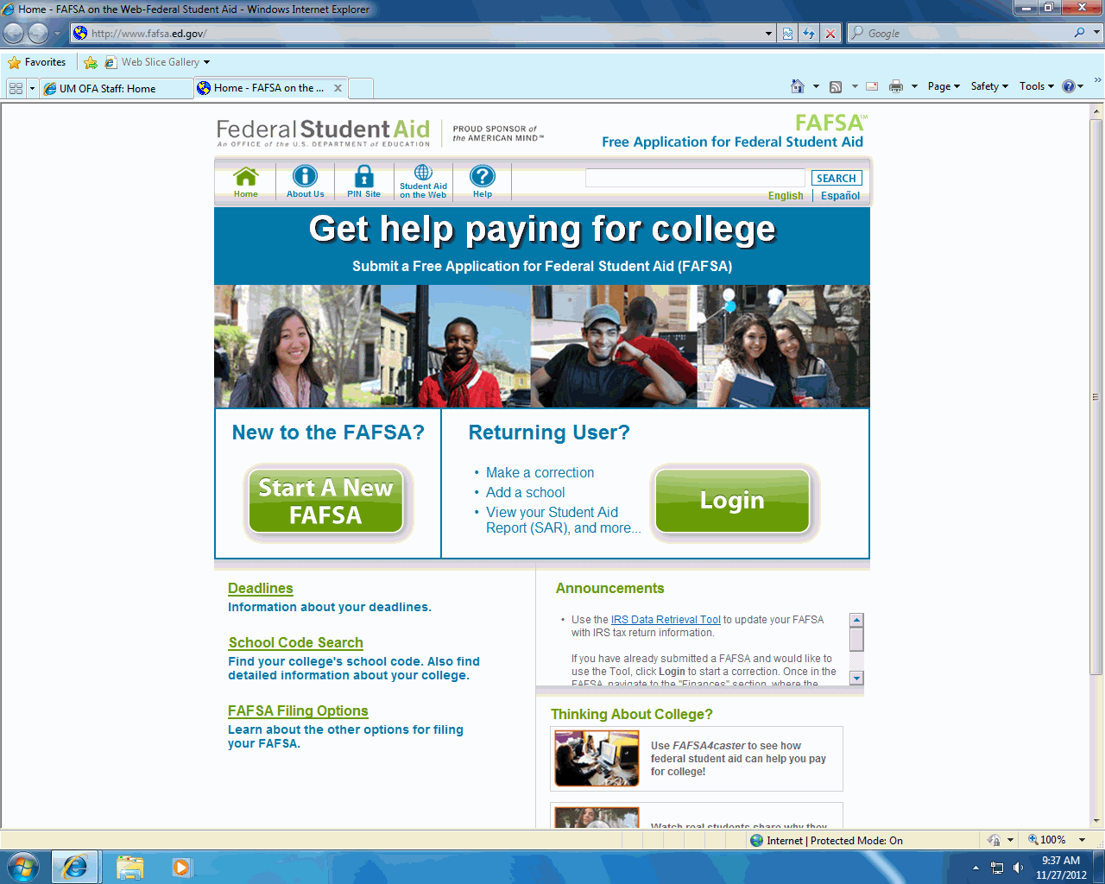
Completing the FAFSA: Why?
Data collected is used to calculate the Expected Family Contribution (EFC), which determines the aid you are eligible for.
Single application for multiple sources of aid
Can list up to 10 schools on application

Slide 29
Completing the FAFSA: Who?
Students must have a social security number (SSN) and be:
  U.S. Citizens
  Eligible noncitizen
    Permanent U.S resident with Permanent Resident Card
    Conditional permanent resident with Conditional Green Card
Parents do not need a SSN

Slide 30
Completing the FAFSA: Who?
Each student
  Option to transfer parental information
Parent(s)
  Both parents (biological, step, or adoptive parents)
  if married
  Only one parent if single, divorced or separated
  (the parent that the student lives with)

Slide 31
Completing the FAFSA: Who?
TRUE or FALSE?
I’m a 20-year-old student, I live by myself
and work to support myself. I don’t have to
use my parent’s information on the FAFSA.

Slide 32
Completing the FAFSA:
Dependent -vs.- Independent
Majority are dependent
  Requires parental information
Independent
  No parental information if*:
    Married
    Graduate school
    At least 24 years old
    Have a dependent that you provide more than 50% support

Slide 33
Completing the FAFSA: When?
2013-2014 Application becomes available
January 1, 2013
State of Michigan deadline is March 1
Check with your school for more specific deadlines
FAFSA is an annual application

Slide 34
Completing the FAFSA: How?
The first in “F” in FAFSA stands for:
  A: Frank
  B: Free
  C: Federal
  D: Financial
  E: Applesauce

Slide 35


Completing the FAFSA: How?
www.fafsa.gov
www.fafsa.com

Slide 36
Completing the FAFSA: How?
2012 Tax Return or
  W2s or year-end pay stub
  2011 tax return*
Bank/Asset Statements
Disability, SSI, Child support statement
Department of Education PIN
  Student AND one Parent
  www.pin.ed.gov

Slide 37
What to Expect on the FAFSA
3 out of 4 sections are student information
1 section for parents or adoptive guardian
“As of today”
Males must register with the Selective Service

Slide 38
IRS Data Retrieval
Federal Student Aid and the Internal Revenue Service collaborated to develop a solution that simplifies FAFSA completion.
The IRS Data Retrieval tool will allow FAFSA on the Web applicants to request and retrieve their income and tax data from the IRS.
Electronically filed tax return information will be available from the IRS in 1-2 weeks, data from paper tax returns will be available in 6-8 weeks.

Slide 39
Frequent FAFSA Errors
Student’s social security number
Divorced/remarried parental information
Student/parent income
Untaxed income
U.S. income taxes paid
Household size
Number of household members in college
Self-help preferences

Slide 40
Making Corrections
If necessary, corrections to FAFSA data may be made by:
  Using FAFSA on the Web
  Submitting documentation to the institution’s financial aid office

Slide 41
What Happens Next?
Complete institutional forms
  CSS Profile
Colleges process information: Verification
  May request additional documentation, most common request is copies of federal tax returns
  Process aid awards for admitted students only
  Aid awards generally start going out in March
Aid awards are simply an offer, not binding

Slide 42
Sample Aid Award
Get Your Degree University COA:$22,450
 | Fall 2013 | Winter 2014 | Accept or Decline
Federal Pell Grant | $1,500 | $1,500
Award of Excellence | $5,000 | $5,000
Federal Subsidized Loan | $1,750 | $1,750
Federal Unsubsidized Loan | $1,000 | $1,000
Federal Work-Study | $1,250 | $1,250
Total | $10,500 | $10,500

Slide 43
Special Circumstances
What should I do?
I’ve been in college for three months now
and my father was just laid off yesterday.
I don’t know how we are going to afford
my tuition for next semester…

Slide 44
Special Circumstances
Cannot report on FAFSA
Send explanation to financial aid office at each college
College will review special circumstances
  Request additional documentation
  Decisions are final and cannot be appealed to U.S. Department of Education

Slide 45
Not All Special Circumstances are Created Equal…
Change in employment status
Medical expenses not covered by insurance
Change in parent marital status
Unusual dependent care expenses
I want more money….
My parents are not willing to help
Elective surgery
VS.

Slide 46
Deric’s Tips & Pointers
Know before you go
Payment plans
Full-time status
Double occupancy
Ask questions
Bigfuture.collegeboard.org
Apply for scholarships every year

Slide 47

College Goal Sunday = FREE HELP!
February 10, 2013
2-4 pm
Locations vary
www.micollegegoal.org

Slide 48
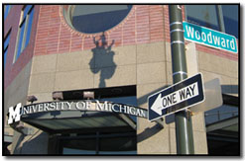
Maize and Blue Days= MORE FREE HELP!
University of Michigan’s Detroit Admissions Office
Tuesdays and Thursdays
1-7pm
Starting mid January

Slide 49
Thank You!!
Any Questions??

Slide 50
For More Information
Deric B. Williams II
  DBWII@umich.edu
  734-763-2941
University of Michigan, Office of Financial Aid
  www.finaid.umich.edu
Federal Student Aid
  www.studentaid.ed.gov
Michigan Office of Scholarships and Grants
  1-888-4-GRANTS or www.michigan.gov/mistudentaid

