Slide 1
Ann Arbor Public Schools
Behavior Intervention Specialist Program
2013-2014
This program is funded by IDEA dollars. Ann Arbor Public Schools has been mandated by the Michigan Department of Education to use IDEA funds for Early Intervention Services for being cited as having Significant Disproportionality for suspension and expulsion for African American students with IEPs

Slide 2
Program Criteria
Failures - in two or more subjects
Attendance/Truancy - more than three occurrences
Discipline - two or more incidents
Referrals - two or more
* Selected General Education at-risk students

Slide 3
Program Objectives
To reduce the frequency of unacceptable behavior and the amount of suspensions and expulsions for general educational at risk students
To provide behavior intervention training and strategies to support the staff that work with the general education students at risk of suspension and expulsion
To help students and families connect with district and community resources that will improve academic success

Slide 4
Academic Data

Slide 5
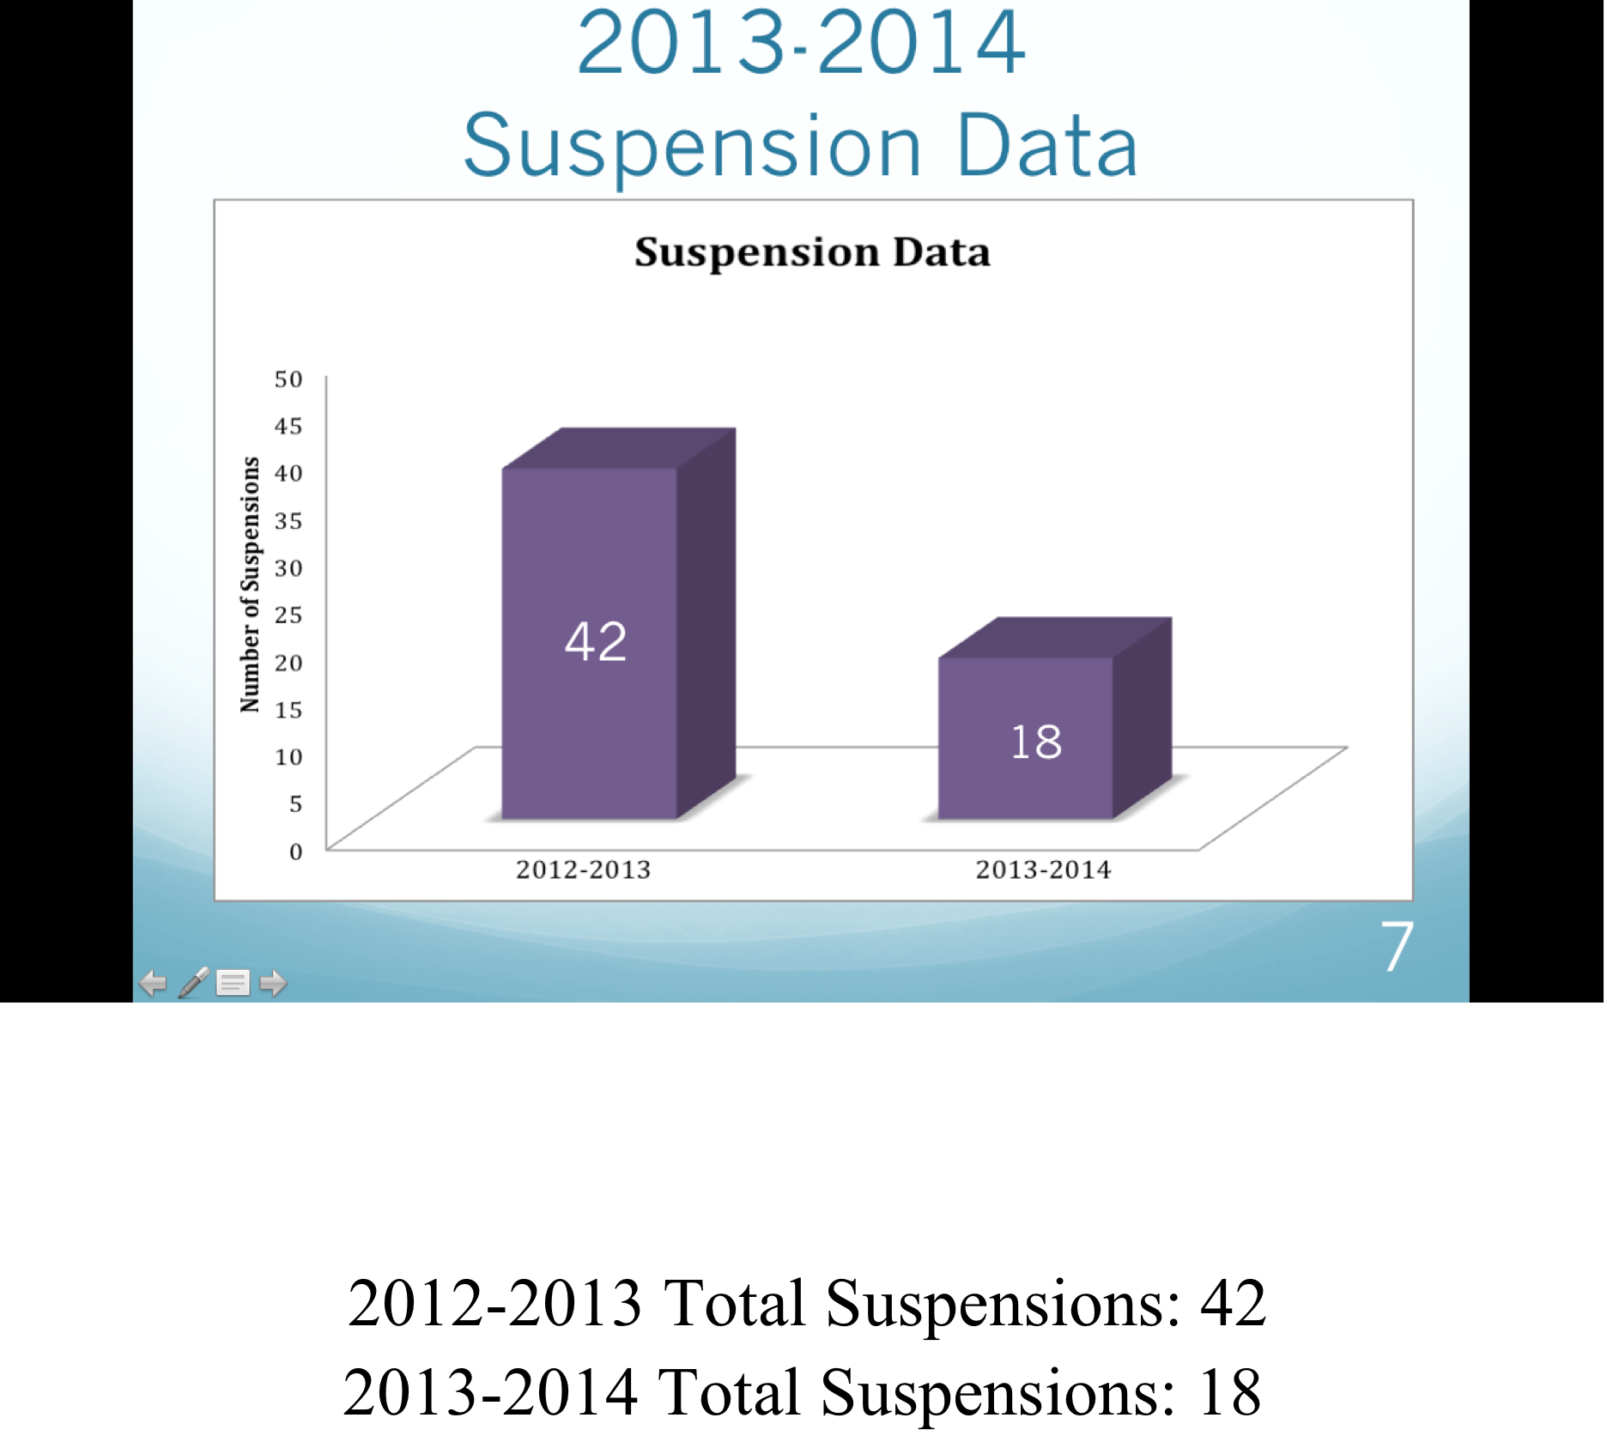
Suspension Data

Slide 6
Intervention Strategies
Build relationships with students and parents are key components in making progress with students (both in and out of school)
Develop Personal Learning Plans for students in need
Observe class and teacher connections regarding students
Facilitate accountability meetings with students weekly and in some cases daily to improve behavior and academic support
Advocate for students
Build rapport with teachers of students on caseload
Create programs that would promote academic success and challenge behavioral issues
Seek and research resources for students and their families
Attend trainings on behavioral intervention, academic resources, and on staying apprised of district initiatives

Slide 7
Programs Developed
Power-N-30 Life Skills Group- Scarlett MS
Life skill development group for 7^{th grade} male students
Champions Program- Pioneer HS
Lunch and After school soft skills program
Leaders of Today and Tomorrow Program- Skyline HS
After school soft skills and tutorial program
Peer to Peer Mentoring Program- Huron HS
Upper class mentoring program for struggling students on
caseload
Future Programs
Breakfast of Champions Program- All 4 Schools
Summer Achievement Camp- All 4 Schools

Slide 8
Questions and Clarifications

Slide 9
POWER-N-30 Life-Skills Group
Scarlett MS
Purpose
To promote an atmosphere of learning that would better equip our male 7th and 8th grade students to be successful academically and socially within the school and community.
Objectives
Students will create a personal journey plan for their academic and behavioral success.
Students will learn cognitive thinking skills that will give them better decision-making skills.
Help students tap into their unlocked potential that would promote a more successful school experience.
Every Thursday from 8:00 am - 8:30am for 9 weeks

Slide 10
Champions Group
Pioneer HS
Purpose
Provide students with a place to discuss academics and social issues. Each student develops goals and discusses the progress of their individual goal. Additionally, students work on soft skills and learn how to become future leaders.
When:
Tuesday, Wednesday and Thursday- Students meet after school to complete class work with teachers and tutors
Friday during Lunch- Students meet for pizza and pop to discuss goals and any issues they want to share

Slide 11
Leaders of Today and Tomorrow Skyline HS
Purpose: To support achievement by enabling students to make a personal investment in their success, through a daily focus on positive leadership, academic growth, and social skills.
Theme: Lead now so I can lead in my future!
Plan: Monday - Friday
FOCUS @ 7:30 AM - 2:25 PM
Focus in on academic achievement and appropriate behavior.
Homework and Tutoring @ 2:25 PM – 4:00 PM
Work independently with teachers and in Skyline Drop-in Center
Leadership & Soft Skills @ 2:25 PM – 5:30 PM
Conflict management, career and goal planning, community service, life simulation games

Slide 12
Peer-to-Peer Mentoring Program Huron HS
Purpose
To provide caseload students with a mentor that can relate to academic and behavioral issues experienced by their mentee.
Objectives
Create a positive relationship between mentor and mentee
Pair a mentee with someone who has faced similar life challenges
Continue communication throughout high school years between mentor and mentee

Slide 13
Breakfast of Champions Program
Purpose
Todays at-risk students are failing academically at high rates. Most are involved in school suspensions, juvenile court, expulsion hearings, and truancy violations. Most of all they are working below their capabilities. The intent is to reach out and help motivate students of color and encourage them to keep dreaming and to challenge them at every turn in life so that they will live life with a purpose. Students need be supported to improve academically and to inspire them to seek higher educational goals.
Objectives
Meet once a month as a group where students can connect with one another in a positive environment that will produce meaningful relationships with professional men and women.
Introduce other professional men and women who also have similar past stories of adversity, that will challenge and motivate students to look beyond their current situations through instructional workshops and small group discussions.
Teach the importance of goal setting. Students will build a life mission statement that challenges them to stay focused on what is important in their lives.

Slide 14
Summer Achievement Camp
Day 1 (August 4-7 10am-1pm)
Purpose
Motivate students to reach for academic achievement and enrichment through goal setting, relationship building, community resources and engagement, and the importance of higher education.
Monday – Scarlett
• Welcome/Purpose
• Words of Encouragement
• Breakout Session Dismissal
• Sessions: 25 min. sessions w/each group rotating
• Motivation to succeed
• Determination in adversity
• Goal focused
• Discovering your purpose
• Groups come back together for dismissal

Slide 15
Summer Achievement Camp
Day 2
Tuesday - Pioneer
• University of Michigan College Tour
• A Connect the Dots session (relating high school education
to higher education and life) facilitated by Behavior
Intervention Specialists Team and U of M volunteers
• Small breakout sessions
• Credits
• GPA
• College Acceptance
• Career Opportunities
U of M volunteers will lead students on a Campus Tour
(Project Inspire Program)

Slide 16
Summer Achievement Camp Day 3
Wednesday - Skyline
• Community Fair
• Stations will be setup with information on community
resources that help support students and families
• AAPS Board of Education
• AAPS Black Parent Support Group
• AAPS PTSO
• Neutral Zone
• 826 Tutoring and Writing
• Education Project for Homeless Youth
• Student Advocacy Center
• Breakout Sessions:
• Students: Success 101 (lead by Behavior Intervention
Specialists Team)
• Parents: Navigating the school system (Lead by Simone
Lightfoot BOE Trustee)
• Keynote Speaker: Paul Saginaw, Founder and Owner of
Zingerman’s will speak to the entire group on “Vision”
• Give out Supplies
• Backpacks, binders, paper, pens, mini calculators, daily
planners, wire bound notebooks, stainless steel rulers, and
portable flash drives

Slide 17
Summer Achievement Camp Day 4
Thursday - Joe Dumar’s Fieldhouse
• Ropes Challenge Course
• Build Trust
• Build Positive Relationships
• Instill hard work and determination
• Build Teamwork
• Instill sense of belonging

Slide 18
Harold Wimberly
Harold Wimberly has served youth at-risk and families in Washtenaw County in various capacities for the last twenty six years, specifically in behavioral counseling, life-skills training and program development for youth. He earned a Bachelor’s of Science degree in Criminal Justice from Eastern Michigan University in 1989. In 1993 Harold was named Youth Counselor of the Year in Washtenaw County and later named Bob Rader’s National Counselor of the Year. In 2013 Harold received the S.L Roberson Community Leadership Award in Washtenaw County. Harold has served in a supervisory capacity the last 14 years of his career.
Harold’s work experience has been with various agencies such as; Washtenaw County Juvenile Court, Boysville of Michigan, Wedgwood Christian Services, City of Ypsilanti Parks and Recreation, and Vista Maria Girls Treatment Facility. In 1996 Harold was a guest lecturer at the University Of Michigan School Of Social Work on the topic of “What Makes a Successful Child Care Worker”. Children’s Protective Services Family Advocacy Program, and Project Impact for Youth program. Harold is the Founder of New Heights Education and Training Program LLC which is a life skills program for at-risk teens. Harold served on the Willow Run Community Schools Board of Education as Vice President for 2yrs.
Harold was ordained as a Teacher and Evangelist in 1996 and later ordained in 2000 as an Associate Pastor at Christian Love Fellowship Ministries Intl. were he serves as the Youth Pastor along with his wife.

Slide 19
Shane Knoll
Shane Knoll was born and raised in Warren, Michigan. He received his Bachelors degree from Michigan State University in Interdisciplinary Studies and Psychology where he ran varsity track and cross -country. Shane then moved to Boston to continue his education. He received his Masters in Severe Disabilities from Simmons College. For the past six years Shane has worked with students with a range of different challenges. Shane has a passion for working with all students and is dedicated to see them succeed. Shane spends his free time with his wife, new baby girl and two dogs.

Slide 20
Brian Buchanan
Brian Buchanan is a Saline High School graduate. He received his Bachelors Degree from Eastern Michigan University in Criminal Justice. After working for five years within the Special Education Department in Saline's Young Adult Program, he went back to school and received his teaching certification in Social Studies from the University of Michigan - Dearborn. Brian is passionate about working with students with a wide range of abilities and also spends his time coaching football for Ann Arbor Public Schools.

Slide 21
Shaenu Micou
Shaenu Micou was born and raised in Ann Arbor, Michigan. He is an alumni of the Ann Arbor Public School District, graduating from Huron High in 1995. Shaenu obtained a Bachelor's degree in Criminal Justice, specializing in Juvenile Justice from Alabama State University. He received his Master's degree in Organizational Leadership and Administration from Concordia University of Ann Arbor. Shaenu has a passion for working in the community. He has over twenty years of experience working with at-risk youth in the surrounding area. He served at Ann Arbor Technological High School, formerly Stone Alternative High School, for nine school years as an avid supporter of students and families. He is married to Madeline Micou a counselor of the AAPS district. They enjoy spending time in the community serving those in need.

Slide 22
Special Thanks
Dr. Elaine Brown – Executive Director of SISS
Gerald Vazquez – Scarlett Middle School Principal
Cory McElmeel – Skyline High School Principal
Dr. Arthur Williams – Huron High School Principal
Kevin Hudson – Pioneer High School Asst. Principal

